Slide 1
Graduate I-20/DS-2019 request guidelines
International student and scholar services(ISSS)
Office of international education (OIE)

Slide 2
BANNER UPDATE
Please make sure that admission decision indicates “ACCEPTED” in student’s BANNER before submitting the I-20/DS-2019 request for a student. OIE is not able to issue an I-20/DS-2019 until the student’s admission decision has been made.

Slide 3
iStart ACCESS: StEP 1
If you don’t have an iStart access, please click here and click “Request iStart access for Department and HR Administrators” under Department & HR access.

Slide 4
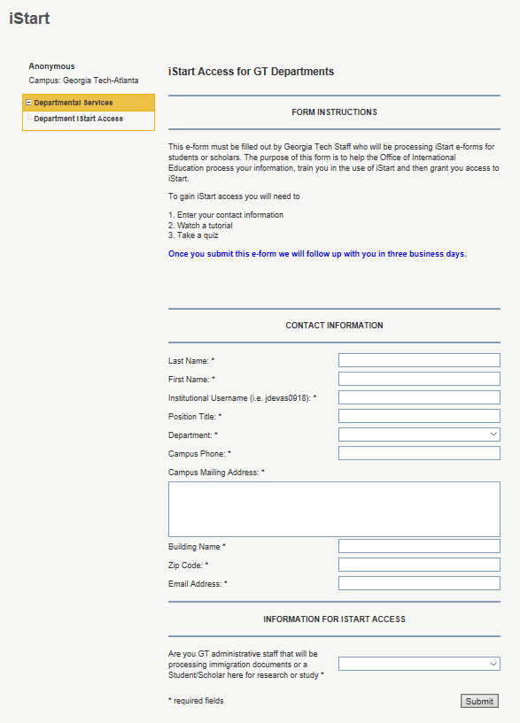
iStart ACCESS: STEP2
You will be directed to fill out the “iStart access for GT departments” e-form.
OIE will follow up with you in three business days after we receive the form.

Slide 5
GRAduate I-20/DS-2019 request
Do you have an iStart access? Yes!
Then you’re ready to submit the graduate I-20/DS-2019 request to OIE.

Slide 6
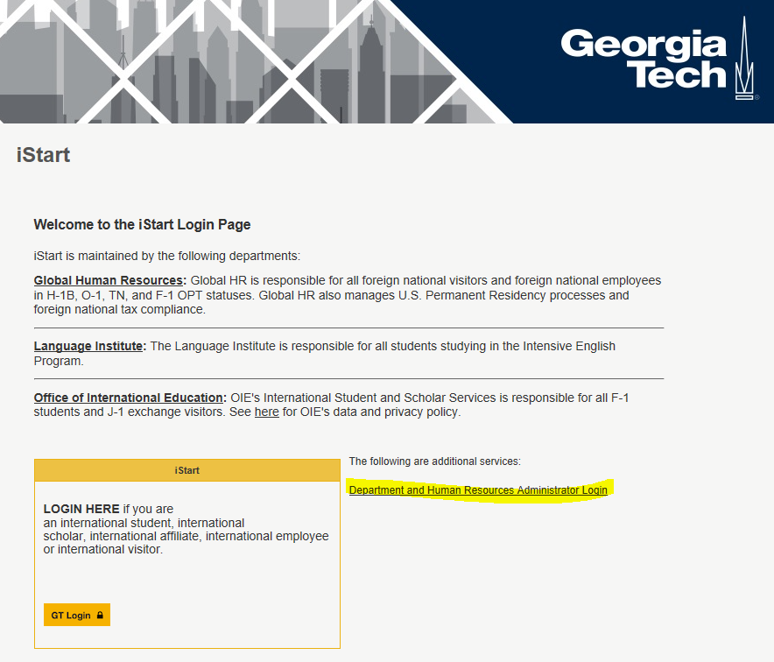
GRAduate I-20/DS-2019 request
Please go to istart.gatech.edu
Click “Department and Human Resources Administrator Login.”
Then you will be directed to login with your GT credentials.

Slide 7
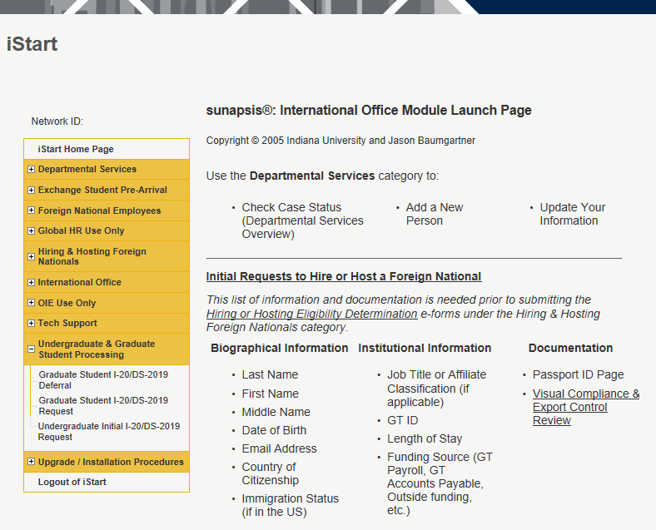
GRAduate I-20/DS-2019 request
3) Please click “Graduate Student I-20/DS-2019 Request” under Undergraduate & Graduate Student Processing

Slide 8
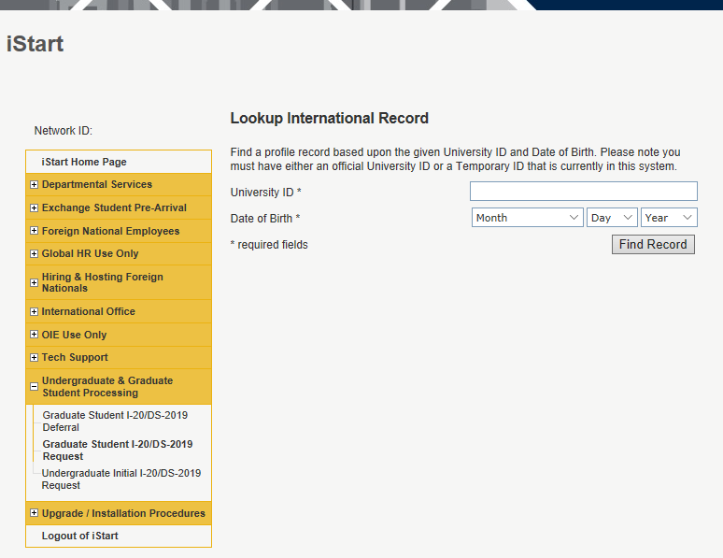
GRAduate I-20/DS-2019 request
4) Enter student’s GT ID # and date of birth.
5) Click “Find Record.”
*If it gives an error message that no record exists,
The student’s admission decision may not been made in BANNER
The student’s BANNER has been recently updated and BANNER needs time to feed iStart. You may try it again next day and if the problem persists, contact OIE.
If none of the above applies, please contact us.

Slide 9
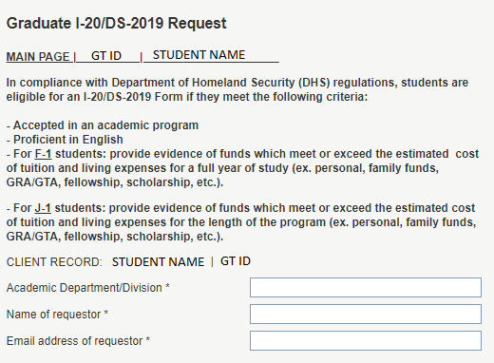
GRAduate I-20/DS-2019 request
6) Click “Start a New Request”
7) Then you will be directed to the “Graduate I-20/DS-2019 Request” e-form. Please fill out the e-form with your department information, your name, and your email address.

Slide 10
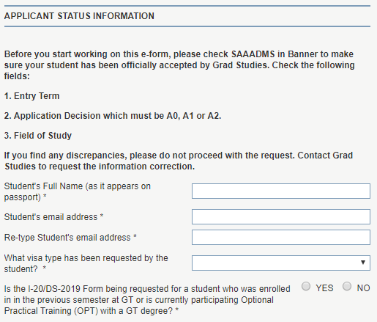
GRAduate I-20/DS-2019 request
8) Please fill out the applicant status information.
**Do not submit the graduate I-20/DS-2019 request if the student is
a current student at GT
a recently graduated student from GT in the last 60 days
a student who graduated from GT more than 60 days ago but is participating in Optional Practical Training (OPT)
If any of the above applies to the student, please do NOT submit the I-20/DS-2019 request. Please direct the student to submit the change of degree level e-form in iStart.
If the student is funded by the government, please contact OIE because it is possible that the student should receive a J-1 visa, not F-1.

Slide 11
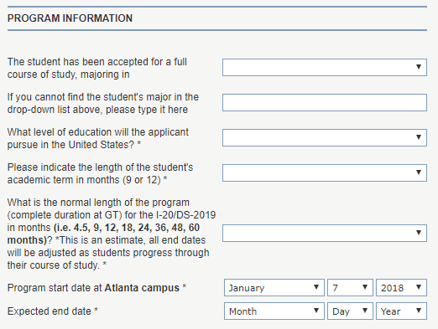
GRAduate I-20/DS-2019 request
9) Please fill out the program information.
Please use “program date tab” in the OIE expense calculator for the start and end dates.

Slide 12
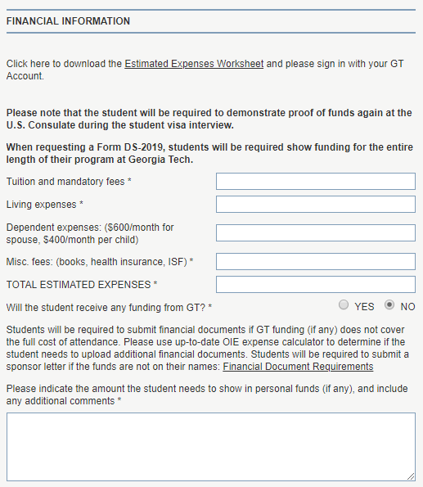
GRAduate I-20/DS-2019 request
10) To fill out the financial information section, please download the up-to-date OIE expense calculator and use OIE expense calculator guidelines that you can download from here.
IMPORTANT: Students use this information to allocate their funding. Please try to enter the correct amount, following the instruction.

Slide 13
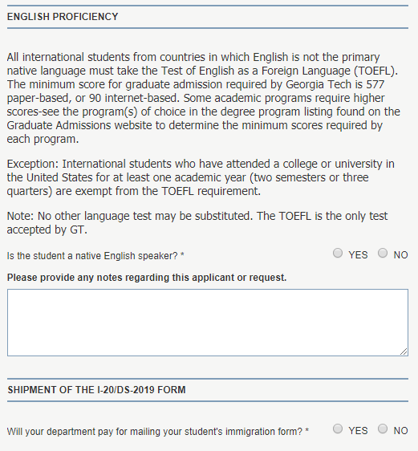
GRAduate I-20/DS-2019 request
11) Please fill out the English proficiency information.
12) Please answer the shipment question.

Slide 14
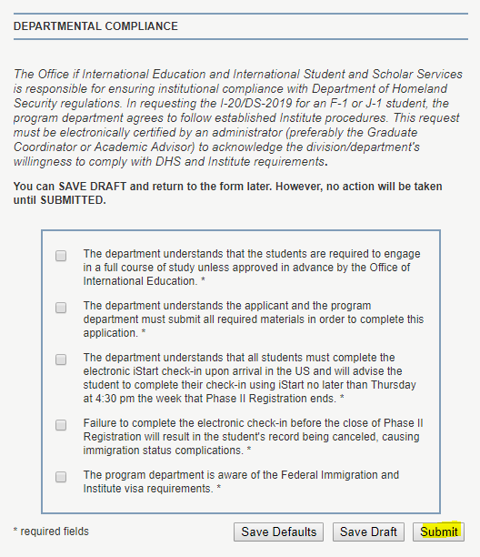
GRAduate I-20/DS-2019 request
13) Please read and check the departmental compliance information.
14) Click the submit button.
- You can click “save draft” if you haven’t finished and want to work on it later.
- After the submission, the e-form will be directed to the student to fill out their part of the e-form. After they submit their part of the e-form, OIE will review the request within 5-7 business days.
15) Congratulations! You have successfully submitted the graduate I-20/DS-2019 request!

Slide 15
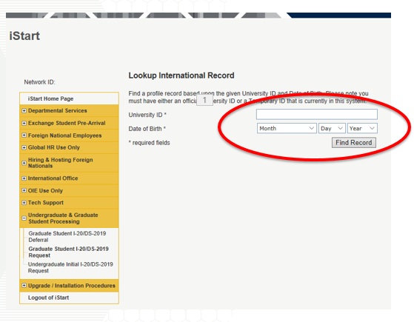
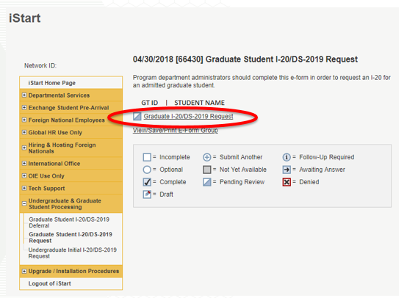
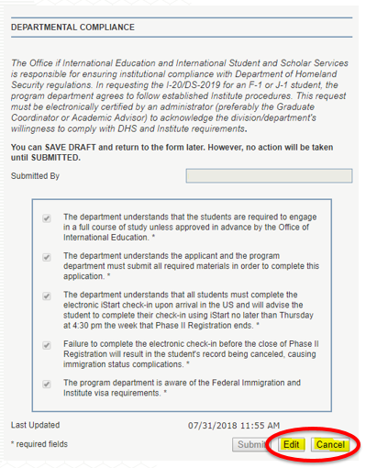
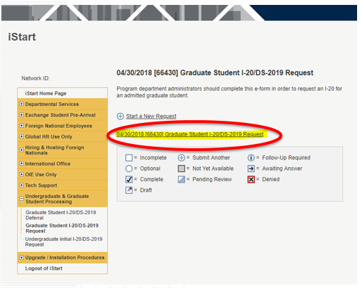
GRAduate I-20/DS-2019 request
Q: How can I edit or cancel the I-20 request?
Go to Graduate I-20/DS-2019 request as you do to request a new one and enter student’s information.
Click the existing request.
Scroll down to the bottom and click “Edit” or “Cancel.”

Slide 16
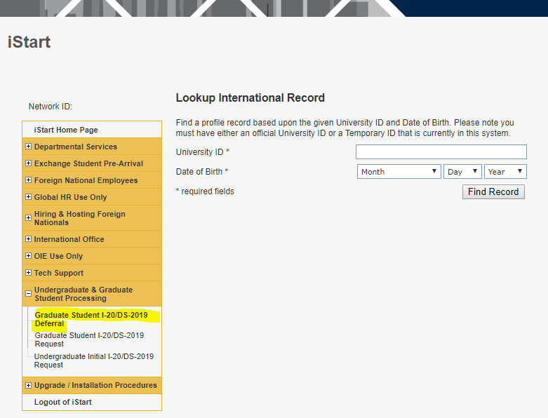
GRAduate I-20/DS-2019 request
Q: Student’s I-20/DS-2019 has been already issued, but his/her admission has been deferred.
Please contact Grad Studies for Banner update so that student’s admission decision indicates “ACCEPTED” for the deferred semester.
Go to iStart and submit the “Graduate Student I-20/DS-2019 Deferral” e-form.
If OIE didn’t issue the I-20 for the student, deferral request is NOT needed. You should submit the new request for the new term.

Slide 17
GRAduate I-20/DS-2019 request
Thank you!!

