Slide 1
Expense calculator Guidelines for grad coordinators (12 months Differential programs)
International student and scholar services,
Office of international

Slide 2
Why is the number so important?
All international students are required to show a proof of adequate financial resources to meet expenses while studying at the U.S. institutions.
International students will use the required funding amount that grad coordinators has indicated in the e-form as a resource to arrange their required funding. If the number is incorrect, the e-form request may be significantly delayed because students will be contacted to provide additional amount or they may have difficulties to arrange unnecessary higher amount of funding.
We understand that expense calculator can be confusing, but the correct required funding amount is extremely important for our students. Please know that your work is appreciated by all international students and OIE!

Slide 3
Most current expense calculator
OIE updates the expense calculator in early April every year once we receive the finalized new tuition values. Please make sure that you have the most current expense calculator.
You can download the most updated expense calculator on our website: https://oie.gatech.edu/isss_estimated_expenses

Slide 4
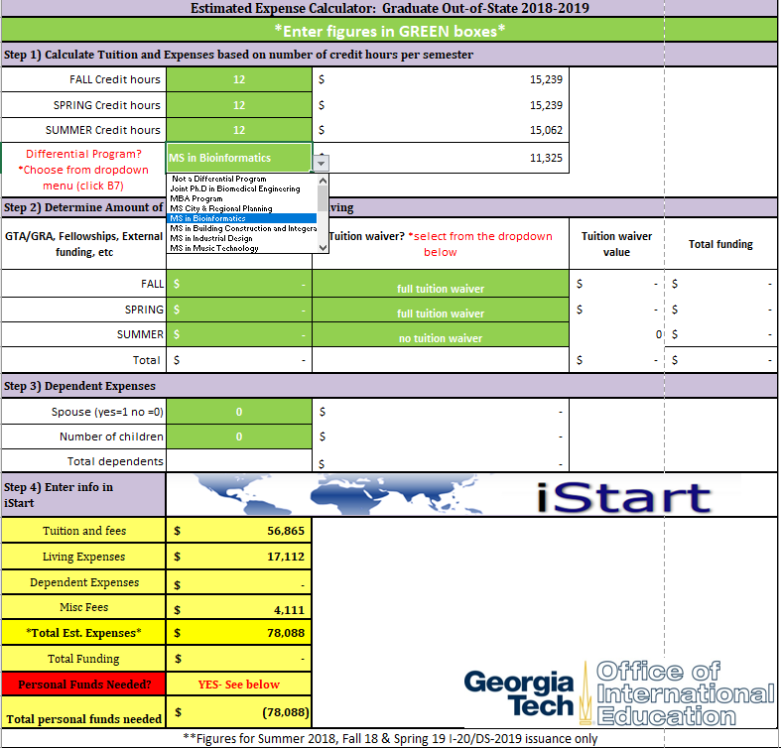
Differential programs (12 mons)
1. Click “Grad OutofState" tab
2. In step 1), enter “12” to Fall, Spring and Summer credit hours.
*If the student will be studying only for certain semester(s), enter “12” only in applicable semesters.
Then choose your department’s program in the dropdown menu.
3. In step 3), enter the number of dependent(s) if there is any.

Slide 5
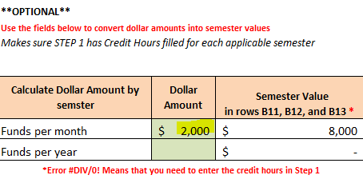
Differential programs (12 mons)
4. If the student receives GT funding, use **OPTIONAL** on the right side of the excel sheet to calculate the GT funding based on the offer letter. You can either use “Funds per month” or “Funds per year.”
*Skip this step if the student does not receive GT funding.
GRA Letter Example (Funds per month):

Slide 6
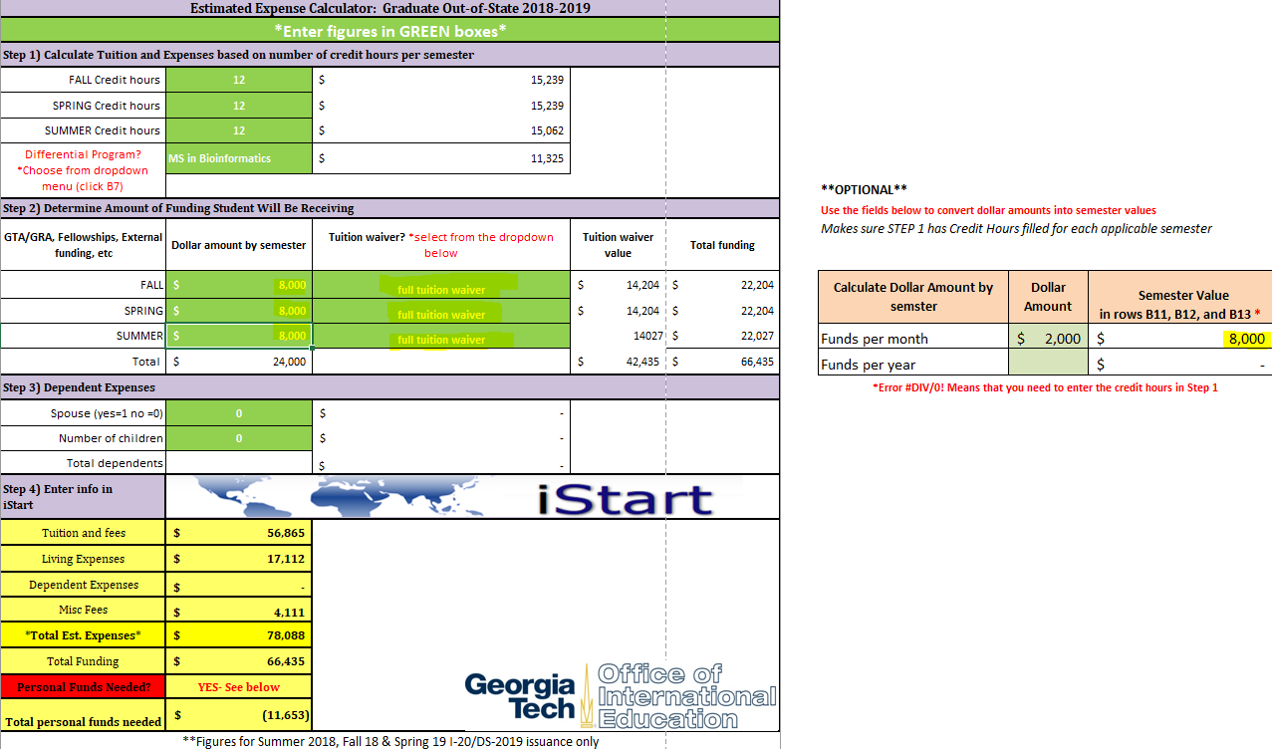
Differential programs (12 mons)
5. In Step 2), enter the calculated semester value from **OPTIONAL** in applicable semester(s), and choose full or half tuition waiver based on the offer letter.
*Skip this step if the student does not receive GT funding.

Slide 7
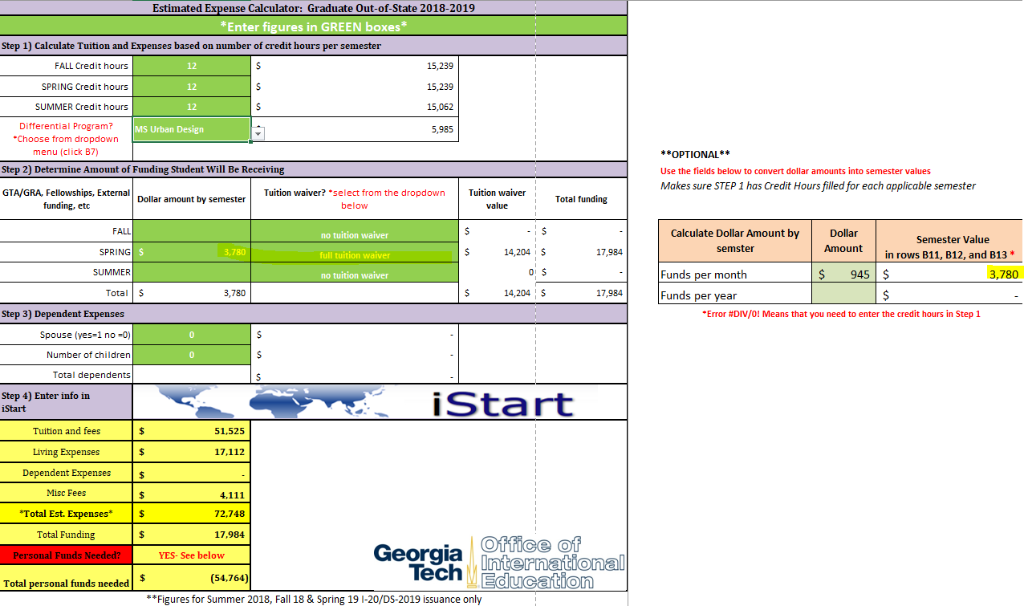
Differential programs (12 mons)
5. *If the student receives GT funding only for one or two semester(s), please enter the funding and select tuition waiver only for the applicable semester(s).
*Skip this step if the student does not receive GT funding.

Slide 8
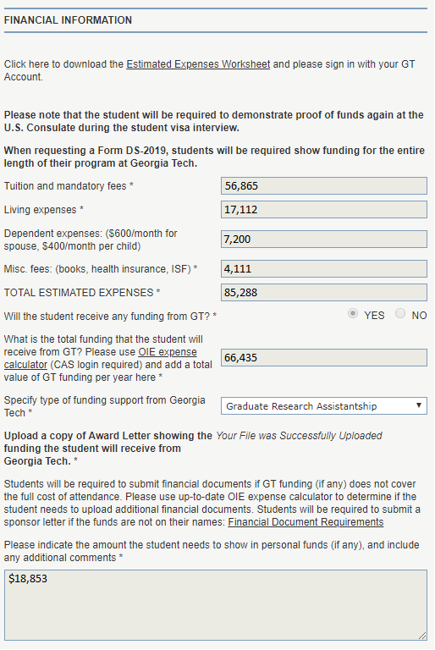
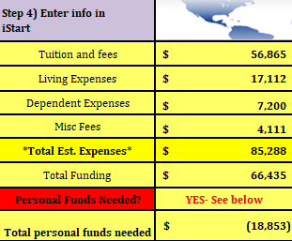
Differential programs (12 mons)
6. Enter the numbers of step 4) in the the financial information section in the e-form.
Now you can fill out the rest of the e-form and all done! Thank you so much! ☺

